Slide 1
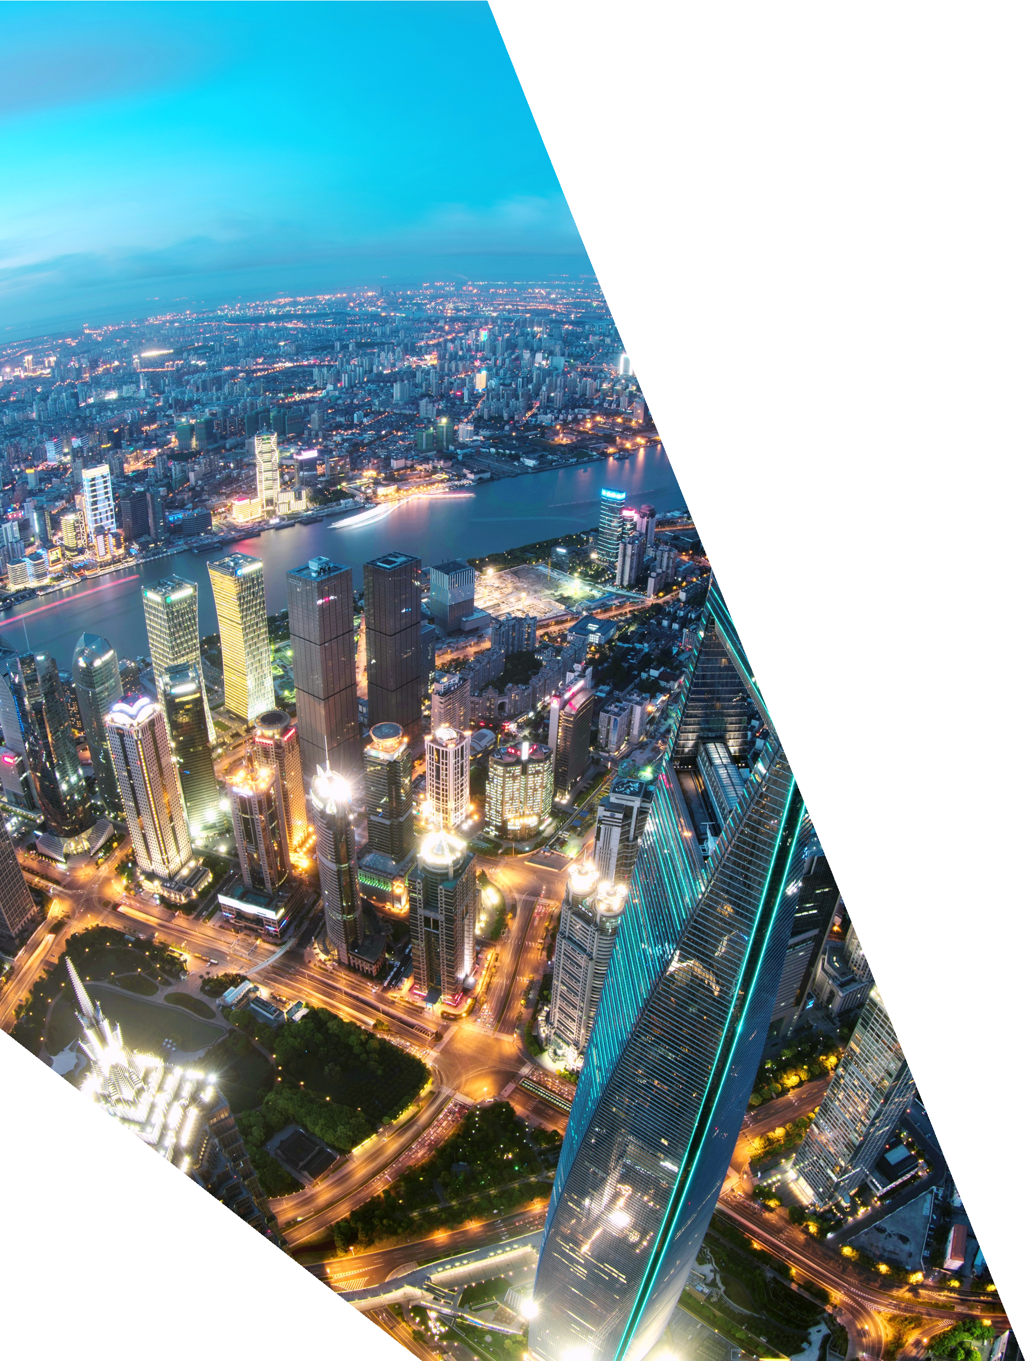




Rescuers (NO MAN Rescue)
1 | Hexagon Overview

Slide 2




CURRENT SCENARIO
More than half of global flood damages occur in Asia.
This process takes more time in identifying the people than in performing the rescue operations. As a result, help to the needy gets delayed resulting in loss of lives and property .
Flood is one of the most devastating disasters in the world.
In the current scenario rescue teams are dispatched to the flood affected areas which in turn includes searching the vicinity for victims.

Slide 3

This is where our solution comes in …

Slide 4







Architecture Diagram
App Server
Video
Processing
Mobile
App
Drones
Person Detection

Slide 5
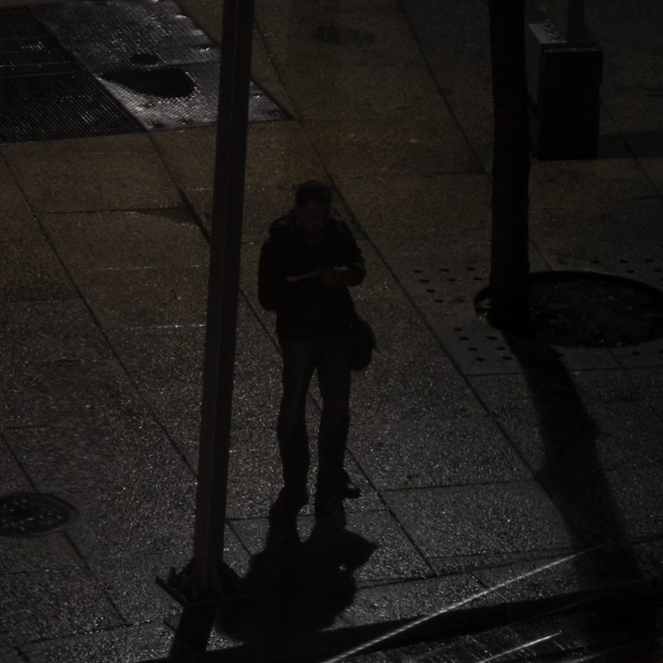
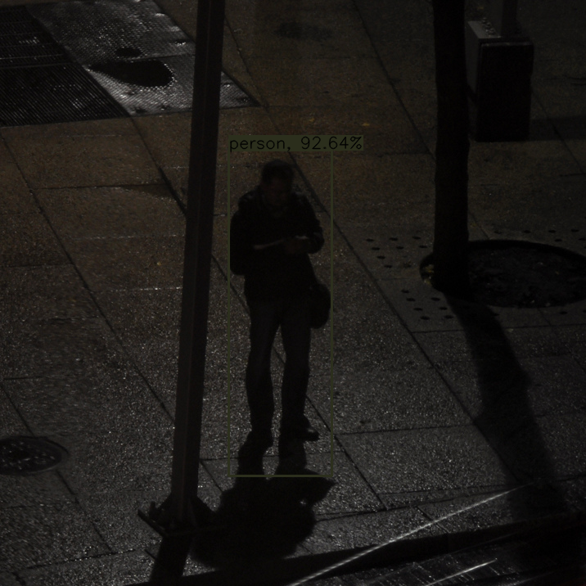
Person Detection in Low light
Captured Image
Processed Image

Slide 6
Architecture Diagram
App Server
Video
Processing
Mobile
App
Drones
Person Detection

Slide 7

Rescuers
Rescuers
FLOOD VICTIMS
Rescuers
Rescuers

Slide 8
Demo’s…

Slide 9
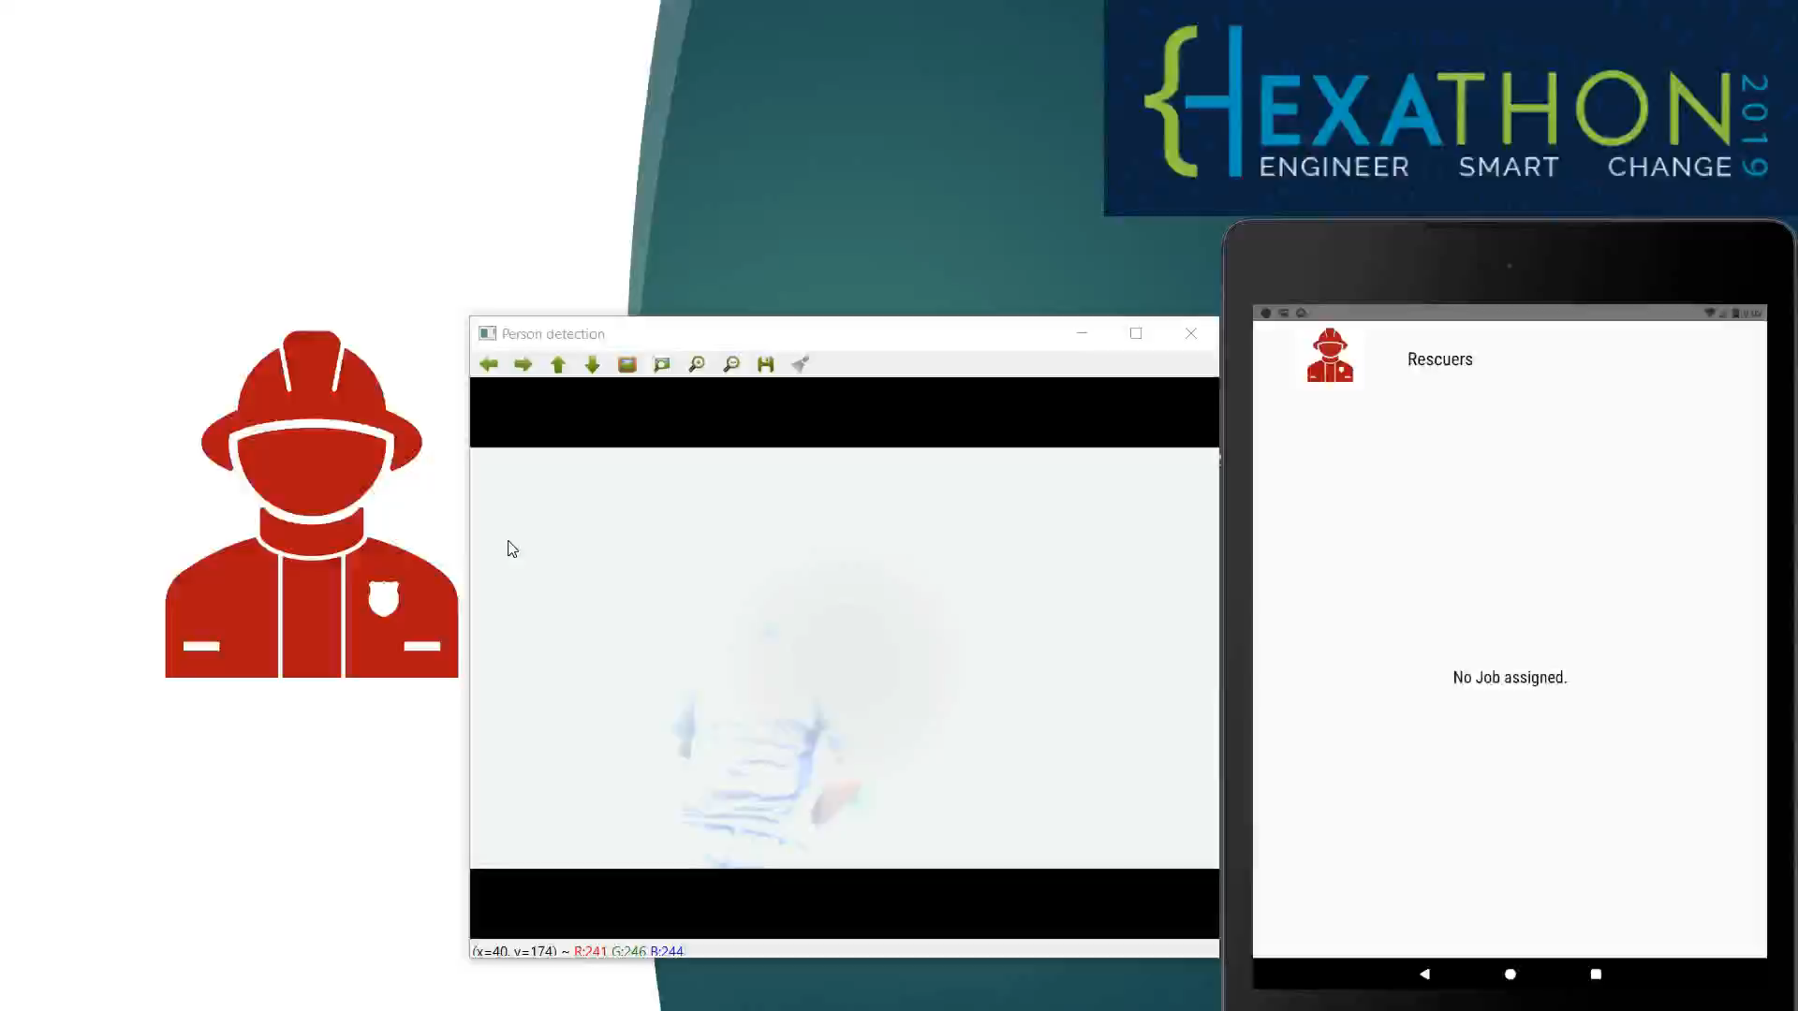
DayLight

Slide 10
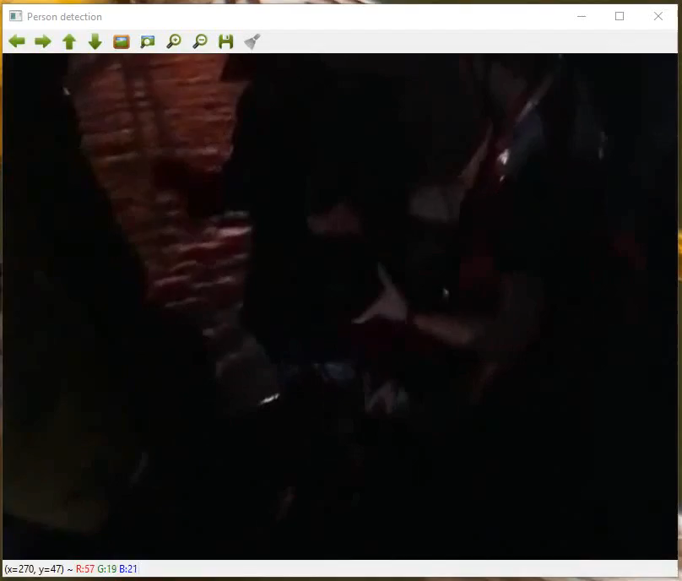
Low Light Person Detection

Slide 11
TECHNICAL STACK
Mobile Application - React Native
Person Recognition – Tensor Flow
Cloud Storage - Firebase

Slide 12

Thank You
Contributors :
Venkatesh Grandhi
Sourish Ghosh
Phaneendra Yedidi
Vinith Reddy Chitteti

